Slide 1
These slides are provided for educational purposes as of April 6, 2023
Note:
These slides are made available to any appropriately requesting individual, regardless of the manner in which they cover, recommend, or participate in the ordering of any Exact Sciences product.
Individuals may use these slides for scientific or educational purposes only.
Exact Sciences does not grant permission to modify the slides or their content and therefore is not responsible for any edits or changes made by a user. This includes, but not limited to, edits or changes to the contents, order, format, and/or incorporation or adoption of these slides or their content into other materials.
The information on these slides may not constitute the most up-to-date data information or data. It is the user’s responsibility to verify the accuracy of these slides for the desired use to comply with applicable rules, laws, or regulations (e.g., event organizer or accrediting body standards/requirements, copyright laws, institutional requirements, etc.).
These slides and their contents are provided: (1) with any faults AS IS AND AS AVAILABLE; and (2) without any assurance, warranty, condition, or duty of or regarding the slides and/or their contents: accuracy, availability, adequacy, validity, reliability, completeness, performance, or compatibility. Exact Sciences disclaims any liability associated with the use of these slides.
© 2023 Exact Sciences Corporation. All rights reserved.

Slide 2
Mt-sDNA Algorithm and Biomarker Analysis Data
04.06.2023 / MED-CG-2200321

Slide 3
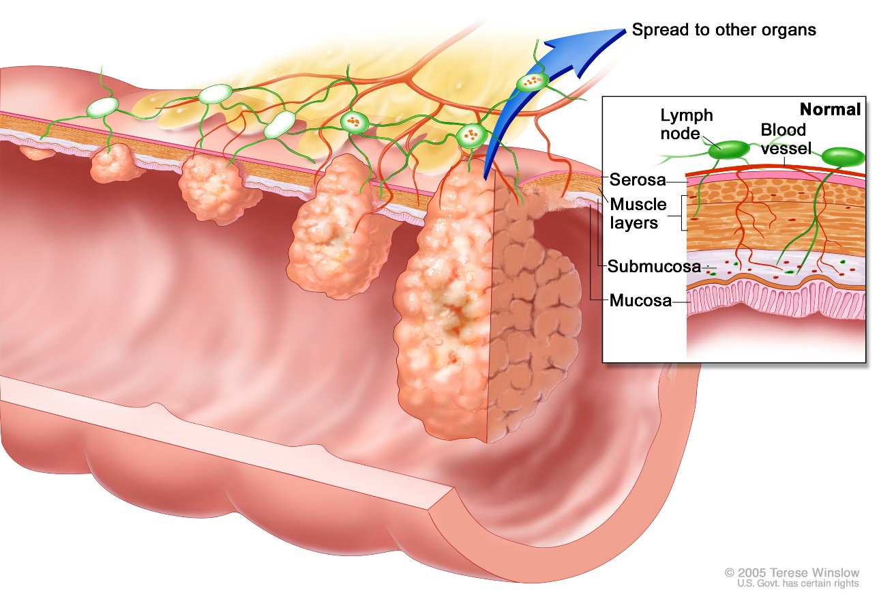
The Science Behind the mt-sDNA Test^{1,2}
DNA biomarkers are continuously shed into the stool^{1,2}
Blood
is intermittently released into the stool²
mt-sDNA looks for the presence of 10 DNA biomarkers plus hemoglobin in the stool sample²
mt-sDNA: multi-target stool DNA 1. Ahlquist DA, et al. Clin Gastroenterol Hepatol. 2012;10(3); 272-277. 2. Cologuard Clinician Brochure. Exact Sciences Corporation. Madison, WI.

Slide 4
The Science Behind the mt-sDNA Test^{1,2}
Detection of potentially pre-malignant lesions (ie, advanced adenomas) is essential for CRC prevention. As bowel lesions grow and develop, they release DNA biomarkers via cellular exfoliation into the stool. This release of markers by exfoliation into stool occurs at similar rates from large precancers and all stages of cancer.
A stool sample can present evidence of precancerous lesions and CRC in the colon and rectum:
Normal and abnormal cells are sloughed into the stool as it passes through the lumen of the colon; these cells are collected from the stool and DNA from biomarkers is isolated for further testing
Blood is also released from polyps, more intermittently in smaller polyps compared with larger polyps
The mt-sDNA test is designed to analyze patients’ stool for the presence of 11 molecular markers, including hemoglobin and DNA markers, which may indicate the presence of colorectal cancer or advanced adenomas
Because cellular exfoliation of DNA into stool occurs continuously, the mt-sDNA test can detect pre-malignant neoplasia at early onset of abnormality
mt-sDNA: multi-target stool DNA 1. Ahlquist DA, et al. Clin Gastroenterol Hepatol. 2012;10(3); 272-277. 2. Cologuard Clinician Brochure. Exact Sciences Corporation. Madison, WI.

Slide 5
How the mt-sDNA Test Works^{1,2}
Negative Result:
Decreased chance of
CRC & Advanced
Precancerous Lesions
2 DNA methylation biomarkers NDRG4 and BMP3
Molecular assays (DNA)
7 DNA mutation biomarkers All KRAS
Algorithm Weighs and combines individual biomarkers
DNA biomarker β-actin*
Positive Result:
Increased chance of
CRC & Advanced
Precancerous Lesions
Hemoglobin assay (Protein)
Fecal hemoglobin biomarker
If a result cannot be obtained due to insufficient sample size, low DNA capture, etc., the Exact Sciences Laboratory will automatically request a second sample, at no additional cost to the patient.
*Reference gene for human DNA quantity.
AA: advanced adenoma; BMP3: bone morphogenetic protein 3; CRC: colorectal cancer; DNA: deoxyribonucleic acid; KRAS: Kirsten rat sarcoma; mt-sDNA: multi-target stool DNA; NDRG4: n-myc downstream-regulated gene 4. 1. Imperiale TF, et al. N Engl J Med. 2014;370(suppl1):1-10, s2-s3. 2. Cologuard Clinician Brochure. Exact Sciences Corporation. Madison, WI.

Slide 6
How the mt-sDNA Test Works^{1,2}
The mt-sDNA test analyzes patients’ stool for the presence of 11 molecular markers, which may indicate the presence of CRC or advanced adenomas^{1,2}
Epigenetic DNA changes characterized by aberrant gene promoter region methylation of NDRG4 and BMP3, genes which have been shown to be hypermethylated in CRC²
Specific DNA point mutations in the KRAS gene; KRAS mutations have been detected in up to 35% of colorectal cancers, and the 7 mutations in Exon 2 detected by the mt-sDNA test account for 98% of KRAS mutations²
The final category of biomarker is non-DNA based and detects hemoglobin, which can be associated with colonic bleeding²
Run control samples for assays are tested along with patient samples to show the process has been performed appropriately.
Based on combined results of all the DNA markers and hemoglobin, a mathematical algorithm determines a single result of ‘negative’ or ‘positive’
A negative test result means that the test did not detect abnormal DNA and/or blood in the sample. A test can also have a negative result that is incorrect (false negative). For that reason, it is important that patients continue a regular screening schedule.
A positive mt-sDNA test means that the test detected abnormal DNA and/or blood that could be caused by precancer or cancer in the colon or rectum. A test can also have a positive test that is incorrect (false positive). Any positive result should be followed by a colonoscopy.
In some cases, the mt-sDNA test may not generate a result. If this occurs a new patient sample may be requested.
CRC: colorectal cancer; Mt-sDNA: multi-target stool DNA
1. Imperiale TF, et al. N Engl J Med. 2014;370(suppl1):1-10, s2-s3. 2. Cologuard Clinician Brochure. Exact Sciences Corporation. Madison, WI.

Slide 7
Mt-sDNA Algorithm Inputs
Methylation markers (strand counts)
KRAS mutation markers (strand counts)
Hemoglobin
BMP3
NDRG4
β-actin (ACTB ANB)
KRAS1
KRAS2
β-actin (ACTB KRAS)
Fecal Hb ng/mL
STEP 1
Apply weighting factors and combine (for BMP3, NDRG4, ACTB ANB, KRAS1, and KRAS2 strand counts and fecal Hb ng/mL)
Logistic score
Logistic score regression formula → Logistic score
STEP 2
DNA marker scores = Either “0” or “10” depending on whether the DNA marker is below (“0”) or above (“10”), the 99.5 percentile of normal
Sum of scores
Sum of scores = Logistic score + BMP3 score + NDRG4 score + KRAS1 score + KRAS2 score
STEP 3
Composite score
Sum of scores subjected to an exponential equation → Range of values from 0 to 1000
RESULT
Negative result: Score <183
Positive result: Score ≥183
ANB: gene panel of ACTB, NDRG4, and BMP3; Hb: hemoglobin; mt-sDNA: multi-target stool DNA.
Imperiale TF, et al. N Engl J Med. 2014;370(suppl1):1-10,s2-s3.

Slide 8
Examples of mt-sDNA Biomarker Analytic Data from Pivotal Study
Sample mt-sDNA Biomarker Analytic Data, Composite Score and Clinical Findings
Study sample case | Mt-sDNA analytic data |  |  |  |  |  |  | Mt-sDNA composite score | Mt-sDNA result | Study colonoscopic finding
 | Mutiplex QuARTS Reaction: Methylation markers |  |  | Mutiplex QuARTS Reaction: KRAS mutation markers |  |  | Immunochemical fecal hemoglobin assay
 | BMP3 strand count | NDRG4 strand count | β-actin (ACT ANB) strand count | KRAS1 strand count | KRAS 2 strand count | β-actin (Kras ACT) strand count | Mt-sDNA fecal hemoglobin ng/ml buffer
Case 1 | 49 | 695 | 7,704 | 59 | 113 | 12,239 | 3 | 264 | Positive | CRC
Case 2 | 64 | 166 | 2,614 | 4 | 3 | 4,070 | 18 | 339 | Positive | CRC
Case 3 | 77 | 472 | 2,908 | 62 | 474 | 6,629 | 10 | 1,000 | Positive | Adenoma with high-grade dysplasia
Case 4 | 45 | 125 | 1,138 | 0 | 0 | 4,820 | 0 | 1,000 | Positive | Sessile serrated polyp ≥ 1.0 cm
Case 5 | 0 | 2 | 226 | 0 | 0 | 907 | 77 | 75 | Negative | Tubular adenoma < 1.0 cm
Case 6 | 3 | 42 | 10,279 | 29 | 61 | 18,634 | 24 | 26 | Negative | Negative
Mt-sDNA: multi-target stool DNA, CRC: colorectal cancer
Imperiale TF, et al. N Engl J Med. 2014;370(suppl1):1-10,s2-s3.

Slide 9
Examples of mt-sDNA Biomarker Analytic Data from Pivotal Study
The previous slide shows sample data from study cases, the resulting calculated Composite Scores from the Algorithm and the corresponding multi-target stool DNA test result, and the study colonoscopic findings.
Imperiale TF, et al. N Engl J Med. 2014;370(suppl1):1-10,s2-s3.

Slide 10
These slides are provided for educational purposes as of April 6, 2023
Note:
These slides are made available to any appropriately requesting individual, regardless of the manner in which they cover, recommend, or participate in the ordering of any Exact Sciences product.
Individuals may use these slides for scientific or educational purposes only.
Exact Sciences does not grant permission to modify the slides or their content and therefore is not responsible for any edits or changes made by a user. This includes, but not limited to, edits or changes to the contents, order, format, and/or incorporation or adoption of these slides or their content into other materials.
The information on these slides may not constitute the most up-to-date data information or data. It is the user’s responsibility to verify the accuracy of these slides for the desired use to comply with applicable rules, laws, or regulations (e.g., event organizer or accrediting body standards/requirements, copyright laws, institutional requirements, etc.).
These slides and their contents are provided: (1) with any faults AS IS AND AS AVAILABLE; and (2) without any assurance, warranty, condition, or duty of or regarding the slides and/or their contents: accuracy, availability, adequacy, validity, reliability, completeness, performance, or compatibility. Exact Sciences disclaims any liability associated with the use of these slides.
© 2023 Exact Sciences Corporation. All rights reserved.

